Slide 1
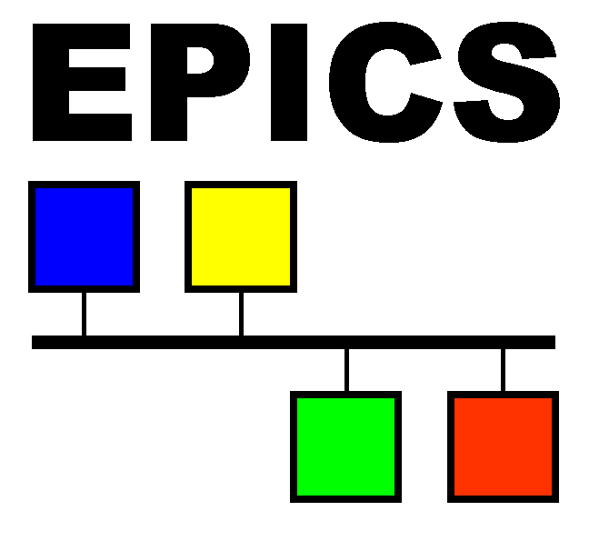
Supporting the next generation of scientific control systems Introduction to V4 Design, Features and Status
Ralph Lange
EPICS Lecture Series
16 Feb 2015

Slide 2
Preface: What V4 Is Not
V4 is not a replacement for V3
V4 does not introduce a new IOC database
V4 does not require you to rewrite all your drivers
V4 does not break existing systems
V4 extends V3, and does not require upgrading

Slide 3
Outline: What V4 Is
pvData: an API to create and manage structured data
pvAccess: a network protocol to efficiently transfer pvData structures across networks (incl. RPC type)
Implementations of pvData and pvAccess (client and server) in C++ and Java
NT types: standard structures covering most use cases
pvaSrv: a pvAccess server running in an IOC, allowing to access EPICS DB PVs (record.field) using pvAccess
Lots of documentation and examples

Slide 4
Benefits: V4 – What is it Good For?
Structured data: Extending the scope of EPICS from I&C to data acquisition, image processing, and beyond
Efficient network transfer (only changed parts of a structure are transmitted): High performance archiving and image transfer
RPC type services: Service oriented architecture, database backends
Atomic access to groups of PVs on an IOC: Writing device setups in one transaction

Slide 5
pvData
Memory resident structured data
Scalar types: integer (1/8/16/32/64 bit, signed & unsigned) float (32/64 bit) string
Enums, unions, structures, arrays of scalar types
Arrays of structures, structures of arrays
Separate interfaces for introspection and data
Client can find out structure before accessing data
Helper classes: factories for creating introspection and data structures

Slide 6
pvAccess
Provides remote (network) access to pvData
Complete protocol specification available
Client/server architecture, multiple providers per server
Codec based, pluggable transports, pluggable security
Focus on network efficiency:
Only changed parts of structures are transmitted
Multiple messages can be packed in one network packet … one message can be spread over multiple network packets
Large array support: allows direct copy between data source/sink and network buffers

Slide 7
pvAccess Request
Client connects to Channel (top level pvData structure)
Client specifies a request, using subset of the server side structure
Process, Put, Get, PutGet, Monitor
Both client and server create containers to hold data
Client executes the request (multiple times)
pvAccess transmits only changed parts over the network

Slide 8
Reference Implementations
Client and Server libraries are available in Java and C++
Python client wrapper is available
Easy pvAccess simplified API is under development

Slide 9
Normative Types – Generic
Well-defined standard structures:
NTScalar: single value plus meta data
NTScalarArray: single array plus meta data
NTEnum: enumeration
NTMatrix: 2d array of double plus meta data
NTURI: uniform resource identifier (e.g. RPC arguments)
NTTable: 2d tabular dataset plus meta data
NTAttribute: key value pair plus meta data

Slide 10
Normative Types – Specific
Well-defined standard structures:
NTMultiChannel: array of PVs (name, value, meta data)
NTNDArray: areaDetector image and meta data
NTContinuum: point series in time or frequency domain
NTHistogram: array of binned data
NTAggregate: statistics for a measurement over time (start time, end time, no.samples, mean, sigma, min, max)

Slide 11
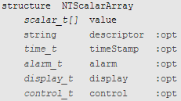
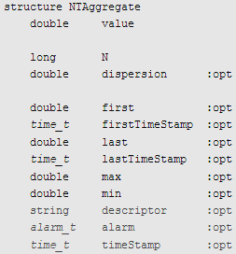
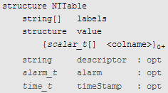
Normative Types – Examples

Slide 12
pvaSrv
pvAccess server running on a regular V3 DB (IOC)
dbPv function:
Zero configuration
Any record.field PV is available as a standard NT structure
(Planned) dbGroup function:
Arbitrary groups of record.field PVs are accessible under a new name as a single container, allowing atomic access
Configuration: static persistent (at IOC boot time) and/or dynamic volatile (on-the-fly as part of the access)

Slide 13
V3 / V4 Interoperability
V4 pvAccess client library handles pvAccess and Channel Access: New clients can connect to V4 and V3 servers. → Does not need any change on V3 IOC.
pvaSrv puts a pvAccess server on top of the existing EPICS V3 DB: New clients can use pvAccess to connect to V3 IOCs. → Needs pvaSrv and V4 libraries on V3 IOC.
(Planned) Gateway handles protocol conversion

Slide 14
Who Is Using V4 at the Moment
Diamond: transferring areaDetector images across the network using pvAccess
Using >90% of physical bandwidth (no compression)
Using >120% of physical bandwidth (lossless compression)
NSLS II: middle layer services provide structured data
E.g. collecting BPM readings into position vector
E.g. ArchiveServer for querying archived data
SNS Beamlines: implementing next generation of controls

Slide 15
Development and Status
V4 Development Group (since 2012):
~6 developers actively involved
Weekly telecon, three face-to-face meetings per year
Currently 4.4.0 release:
Usable (beyond beta)
SNS are beating the bugs out (unit tests do not cover extreme conditions)
Next planned releases:
4.4.1 (May): bugfixes, Base 3.15 compatibility
4.5 (fall): Base 3.16, grouping PVs on an IOC

Slide 16
Conclusions
V4 extends V3 without replacing the existing IOC.
pvData and pvAccess add flexible structures and an efficient network protocol.
Set of well-defined containers allows generic clients to handle most applications.
Beyond beta status, first in-production users are happy.
Some important parts (Gateway, PV grouping) are still under development.

Slide 17
Questions? Comments?
Possible applications in CODAC?
Need for fusion specific NT container types?
…
Thank you for your attention.

